Slide 1

SPOTIFY SQL PROJECT

Slide 2

What are the total sales and revenue generated by each artist?

Slide 3
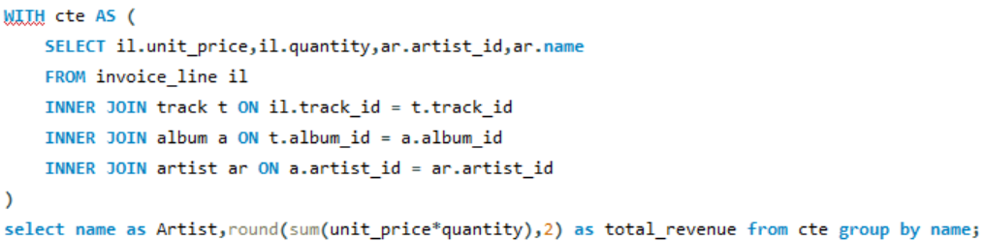
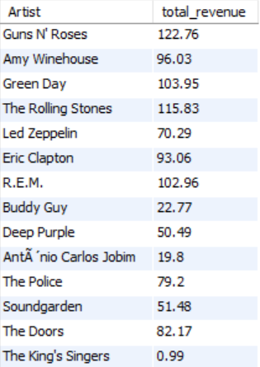
QUERY
OUTPUT

Slide 4
Which albums have generated the highest revenue (Top 5)?

Slide 5
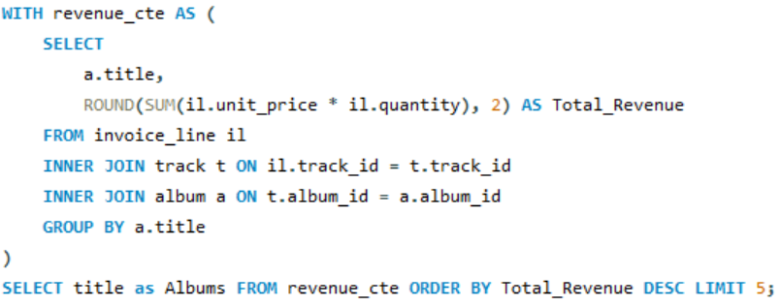
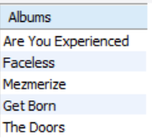
QUERY
OUTPUT

Slide 6
Which genres contribute most to revenue (Top 5)?

Slide 7
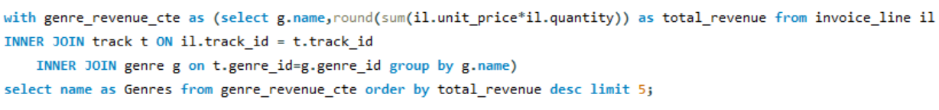
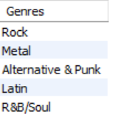
QUERY
OUTPUT

Slide 8
What is the trend of sales over time (yearly)?

Slide 9
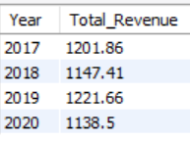
QUERY
OUTPUT

Slide 10
Which customers have made the most purchases (top 5)?

Slide 11
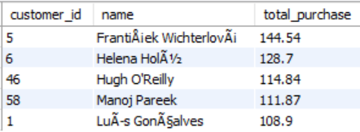
QUERY
OUTPUT

Slide 12
Highest grossing city in each country?

Slide 13
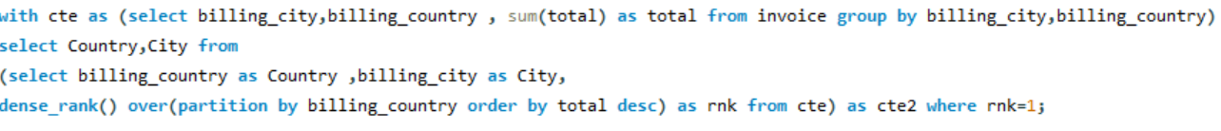
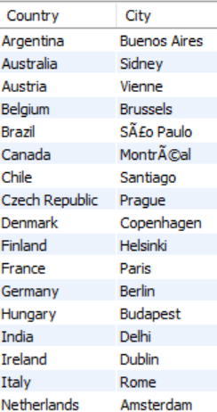
QUERY
OUTPUT

Slide 14
Popular genre in each country ?

Slide 15
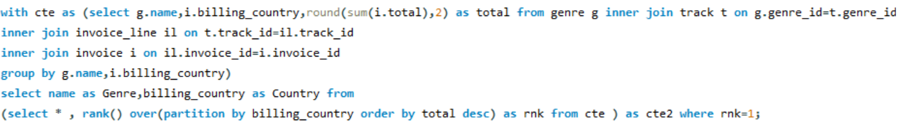
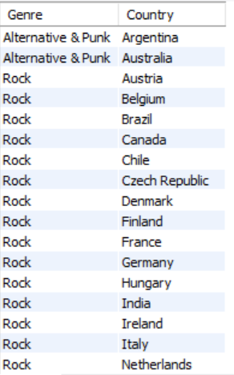
QUERY
OUTPUT

Slide 16
Which tracks are the most purchased or streamed (Top 5)?

Slide 17
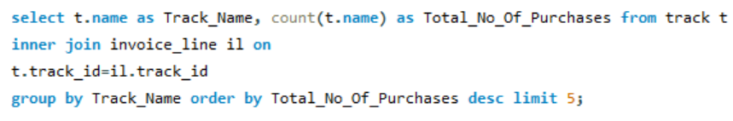
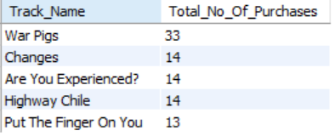
QUERY
OUTPUT

Slide 18
Which employee has generated the highest total invoice amount?

Slide 19
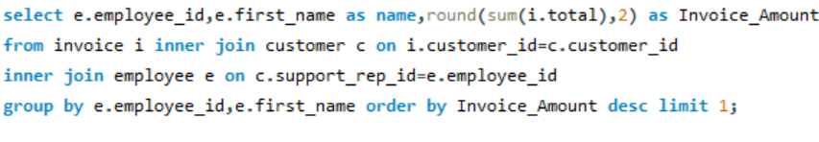

QUERY
OUTPUT

Slide 20
What is the total revenue generated by each employee ?

Slide 21
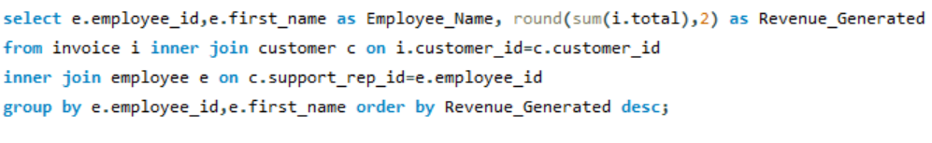
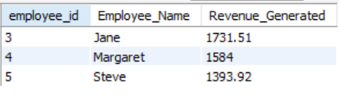
QUERY
OUTPUT

Slide 22
What is the number of invoices per customer ?

Slide 23
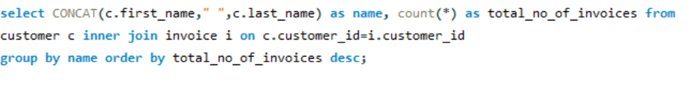
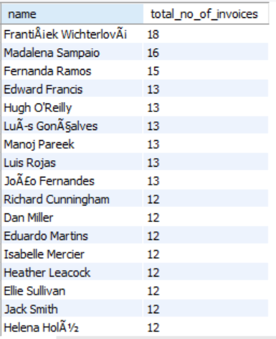
QUERY
OUTPUT

Slide 24
Which city has the highest number of customers ?

Slide 25
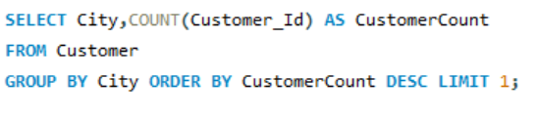

QUERY
OUTPUT

Slide 26
Which tracks are the most sold, and how many times were they purchased ?

Slide 27
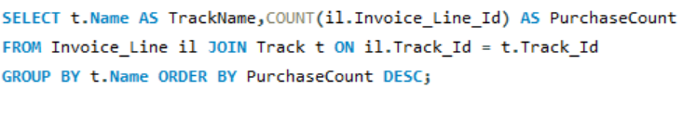
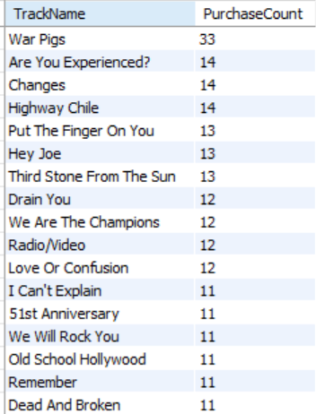
QUERY
OUTPUT

Slide 28
Which artists have the most tracks in the library ?

Slide 29
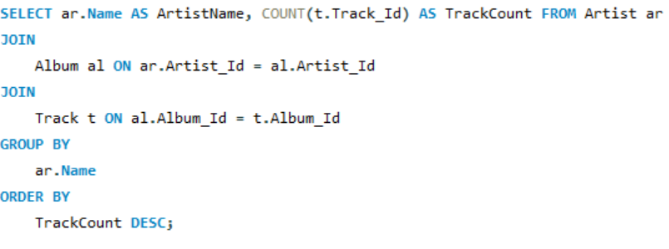
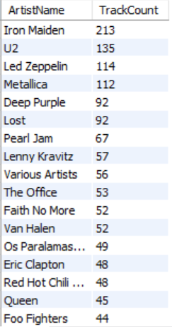
QUERY
OUTPUT

Slide 30
Which employees are interesting the most customers ?

Slide 31
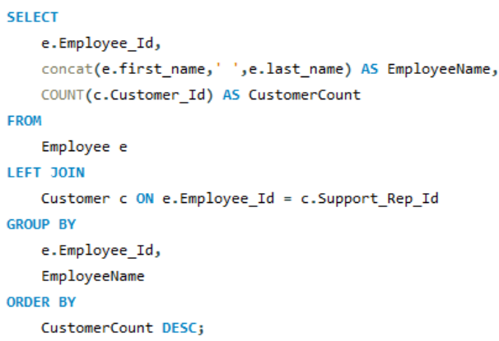
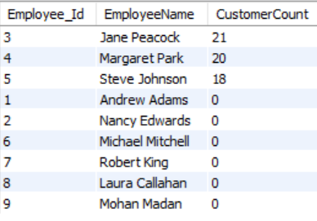
QUERY
OUTPUT

